Slide 1
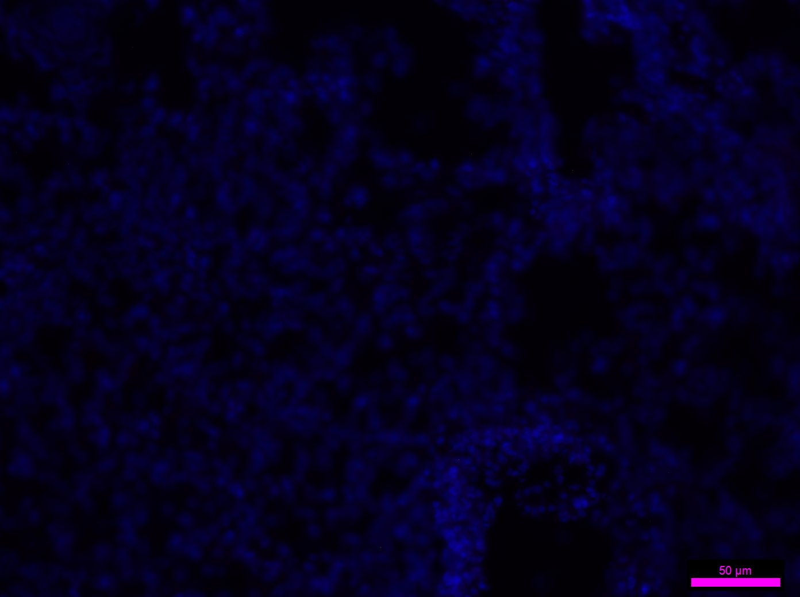
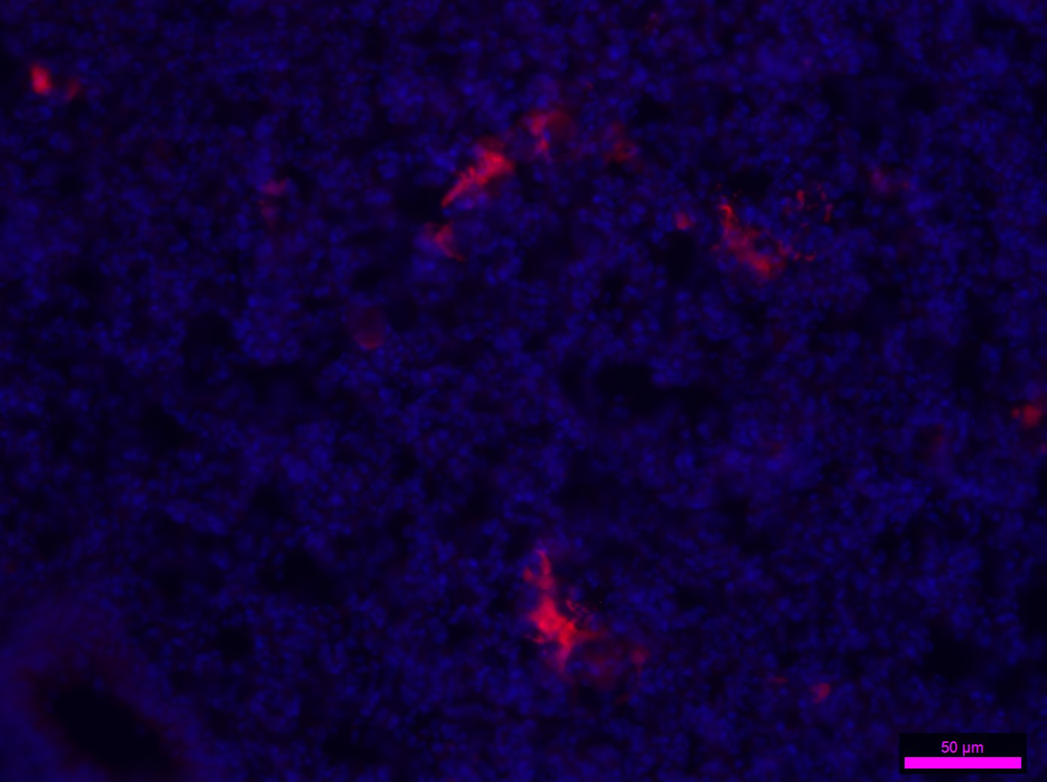
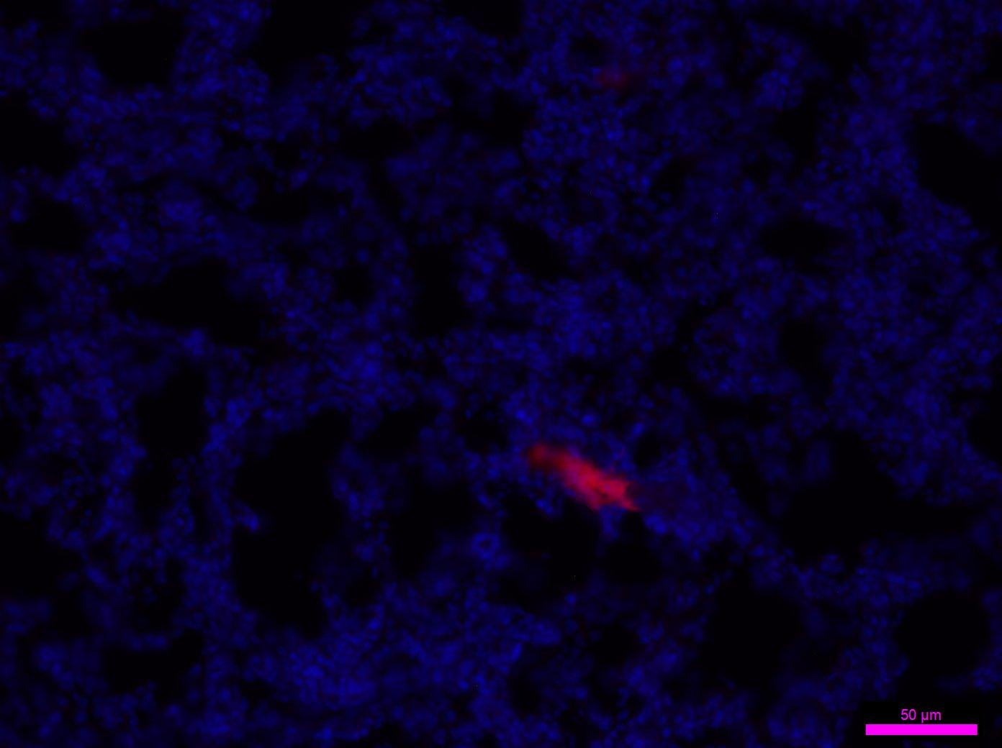
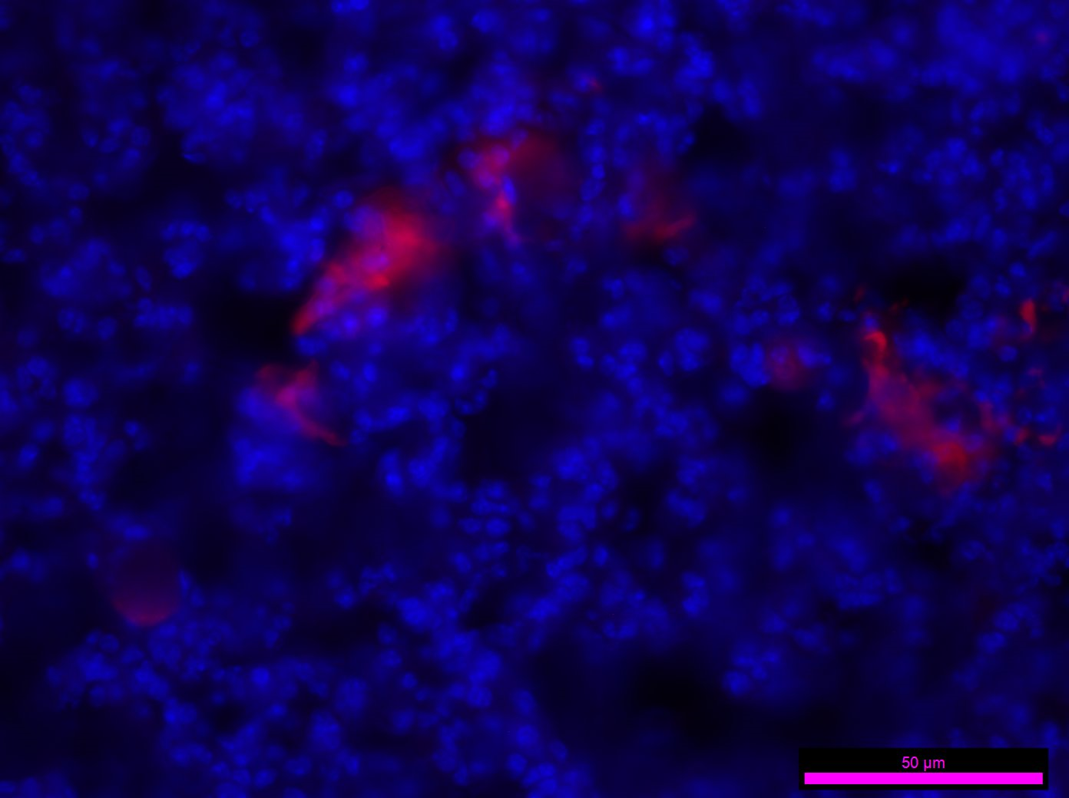
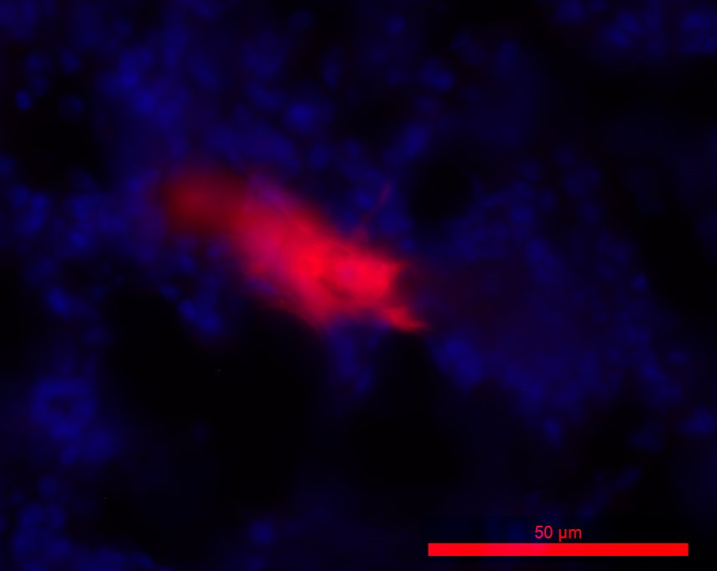
control
2h
24h
Low power
High power
Figure 3. Detection of TdTomato-expressing hUC-MSCs in frozen sections of mouse lung. Lungs from the following animals were analysed: (i) control animals where no cells were administered; (ii) animals where lungs were isolated 2h after TdTomato+ hUC-MSCs were administered IV; (iii) animals where lungs were isolated 24h after TdTomato+ hUC-MSCs were administered IV. Using an exposure time of 1.2s, no red fluorescence was present in the control lungs, but red fluorescence hUC-MSCs were present in samples at 2h and 24h post administration. Analysis using lower power (20x) objective showed that there were more cells in the 2h samples. Analysis using high power (40x) objective showed that nuclei were present in the red fluorescent cells, indicating that they were likely to be viable. Scale bars, 50 µm.

